Slide 1



Cloud Native Workshop
The Cloud Native Platform
Pivotal Cloud Foundry
Notes:
I want to talk to you about cloud native applications, and bringing microservice architectures into production in the enterprise.

Slide 2
Cloud Native Application Platforms
Business Value, Agility & Cost Savings
Traditional IT
IaaS
Cloud Native
You Manage
Applications
You Manage
Applications
Applications
Data
Data
Data
You Manage
Runtime
Runtime
Runtime
Middleware
Middleware
Middleware
Pivotal CF
+
Choice of IaaS
O/S
O/S
O/S
Virtualization
Virtualization
Virtualization
Servers
Servers
IaaS
Servers
Storage
Storage
Storage
Networking
Networking
Networking

Slide 3

Platform Runtime
Services
Routing
Container Scheduling
Service Discovery
Configuration
Database
Application Framework
Big Data
12 Factor Apps
Microservices
RESTful Services
Circuit Breakers
Object Storage
Mobile
Spring Boot
Ruby on Rails
Node.js
.NET
Build CI
Logging & Metrics
Messaging
User Provided
Operations
Zero Downtime Deployments
Failover & Recovery
Scaling
Security Patching
Platform
Upgrades
Infrastructure
VMware
OpenStack
Amazon
Notes:
Let’s go into a little more detail about the components that actually make up Pivotal Cloud Foundry.
We the applications, which is where this starts. You need to select an application framework that lets you build these distributed systems.
We have a platform runtime, which handles routing etc. Attachable backing services for data, CI, and whatever your need
This is built on an operations layer
It does all this on Vmware and Openstack in your data center, plus Amazon public cloud. If each of those infrastructures was an electricity grid, Cloud Foundry would be the travel adapter. You get a single deployment API and set of backing services, so you can port applications with no code changes.
It comes down to this: Would you rather have developers spend their time building a platform, or using one?

Slide 4






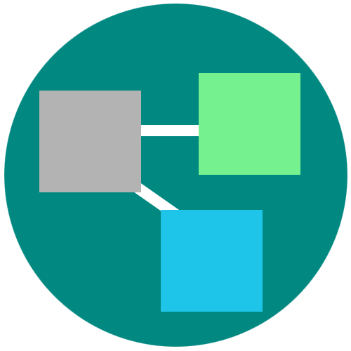
A platform for keeping promises
Roles and Policy
Log aggregation
Security and Isolation
APM
Scaling
APPLICATION
Health management
Blue green deployment
4
Notes:
Its no longer about running an app on a single VM and relying on Vm centric scaling to manage demand.
PCF provides an abstraction layer that allow you to scale out with application containers as the unit (not the VMs). So…You will no longer need to know which VM or where your app container is running because PCF surfaces visibility at the app layer and not though infrastructure constructs like VMs. We call this an application “dial tone”
This along with a high degree of automation with no additional wiring needed is what radically simplify application operations
You can do really rapid blue-green deployment, A/B testing, health management needed for the resiliency and fast updates of your apps. It has built in features that wrap full lifecycle management like APM, log aggregation. Policy enforcement and role based access to resources are all integrated and can be set.
Everything that you need for an enterprise grade distributed app container management system is right there.

Slide 5
Staging and Buildpacks
Buildpacks are responsible for preparing the machine image for an application.
}
Application
Buildpack
Container
Libraries
Droplet
Cell
Runtime
Operating System
Notes:
bin/detect
The detect script is used to determine whether or not to apply the buildpack to an application.
bin/compile
The compile script builds the droplet that will be run by the Cell and will therefore contain all the components necessary to run the application.
bin/release
The release script provides feedback metadata back to Cloud Foundry indicating how the application should be executed.

Slide 6
Buildpacks
Buildpacks installed into a Cloud Foundry instance or loaded from an external location at app deployment time
Buildpacks provided by public Cloud Foundry
Cloud Foundry Community Buildpack
Write you own
Java
Ruby
Node.js
Go
Python
PHP
Notes:
Java
Ruby
Node.js
Custom Build packs

Slide 7

Application Staging
Blobstore
DB
Service
credentials
creds
Cloud Controller
Cloud Controller Bridge
Task
Router
CELL
System
Buildpacks
Detect
Compile
Upload
Yes
No
+
=
Cloud Foundry
Elastic Runtime

Slide 8

Overview: Pushing an Application
Blobstore
Service
credentials
Upload app bits and metadata
DB
push app
+ app metadata
Cloud Controller
Service Broker Node(s)
Create and bind services
Stage application
Deploy application
Manage application health
Router
Cloud Controller Bridge
BBS
CELL
Cell
CELL
CELL
+
=
Auctioneer
Notes:
Cloud Foundry PaaS – Pushing an Application with Diego
App deployment: what has changed?
1- Domain specific (notion of apps) -> Abstractions (notions of LRPs and Tasks). App staging is a Task. App start is launching a LRP.
2- Platform specific (linux) -> Supporting multi platform (Windows & Linux) enabling running also .NET apps, thanks to our new Container implementation: Garden
What’s more, there is a 3rd workflow supported: Docker on Linux
3- New Auction-based workload scheduler: Cloud Controller no longer in charge of deciding where AIs are spun up. Auctioneer manages the process running an auction, making it more optimized.
With Diego in place, more loosely-coupled components take part in the process, stripping down the Cloud Controller from too many previous responsibilities, making it easier to maintain and evolve the entire architecture.
The Cloud Controller handles the routing of client requests internally through the Cloud Controller Bridge. It also manages the Blobstore to store packages and droplets and the DB to store App Metadata and Service credentials. Blobstore could be internal or external, depending on the setup.
A service gateway provides an interface for services (native or external).
More in the next slide about the Cloud Controller Bridge (CC-Bridge), the Bulletin Board System (BBS) and the Auctioneer in the next slide
Apps run in a CELL, part of the new Cloud Foundry Runtime, called Diego
Routers manage application traffic.
Diego handles all health management for apps (now LRPs), through a series of single-purpose components: Nsync (part of the CC-Bridge), BBS (part of Diego DB) and the Converger (part of the Diego Brain)
Apps are accessed directly through the router while web and CLI clients (e.g., vmc, STS) access Cloud Controller via RESTful services.

Slide 9
Deploying an Application
Cloud Controller
Cloud Controller Bridge
Auctioneer
BBS
Router
ACCESS APP
CELL
CELL
CELL
Rep
Rep
Rep
Executor
Executor
Executor
Notes:
The Cloud Controller passes requests to stage and run applications to the Cloud Controller Bridge (CC-Bridge), and it is no longer in charge of allocating the work.
The CC-Bridge translates app staging and app running requests into Tasks and Long Running Processes(LRPs) respectively, then submits these to the Bulletin Board System (BBS) through an RPC-style API over HTTP.
It is a key component to support Diego’s abstractions and maintain the Cloud Controller API unchanged and handling the same calls from the CLI
Domain specific (notion of apps) -> Abstractions (notions of LPRs and Tasks). App staging is a Task. App start is launching a LRP.
Sub-component responsibility:
The stager takes care of staging requests passing them to the BBS
The nsync takes care of updating the DesiredLPR in the BBS so that new apps can start running.
The CC-Uploader helps at the end of the staging process: Mediates uploads from the Diego Executor to the Cloud Controller Blobstore
The Bulletin Board System (BBS) submits the Tasks and LRPs to the Auctioneer, part of the Diego Brain
Maintains a real-time representation of the state of the Diego cluster, including all desired LRPs, running LRP instances, and in-flight Tasks
The Auctioneer distributes these Tasks and LRPs to Cells through an Auction.
There are two components in Diego that participate in auctions:
The Auctioneer is responsible for holding auctions whenever a LRP needs to be started.
The Rep represents a Diego Cell in the auction by making bids and, if picked as the winner, running the LRPs.
All auctions are held by one Auctioneer with the others standing by as backups in case of failure.
The Auctioneer communicates with Reps on all other Cells when holding an auction.
Only one Auctioneer working at a time. Only one auction can take place at a time.
An Auctioneer initiates an auction when it receives a request to allocate a batch of work (tasks and LRPs) either from:
In response to a request from the Cloud Controller via the CC-Bridge.
The Converger, in response to a mismatch between the desired LRPs and actual LRPs as represented in the BBS.
The Auctioneer queries the state of each Cell via a request to the Cell Rep. The information provided by the Rep includes:
the Cell’s available capacity
the Cell’s stack (windows or linux), important since the Auctioneer checks all cell reps, and it might be trying to run an app compatible only with some cells not all of them.
the set of Actual LRPs currently running on the Cell
Once the Auctioneer assigns a Task or LRP to a Cell, an in-process Executor creates a Garden container in the Cell. The Task or LRP runs in the container.
Thanks to Diego platform agnostic, now these (Garden) Containers can be Linux or Windows. Both implement a generic Garden Interface so that the platform-agnostic Garden can manage either.
Once an App is running in its Container it can be directly accessed through the Router directly into the Cell.

Slide 10


D e m o
Pivotal
Cloud Foundry
®
Notes:
DEMO
cf push
Explain actions happening
open http://…

Slide 11

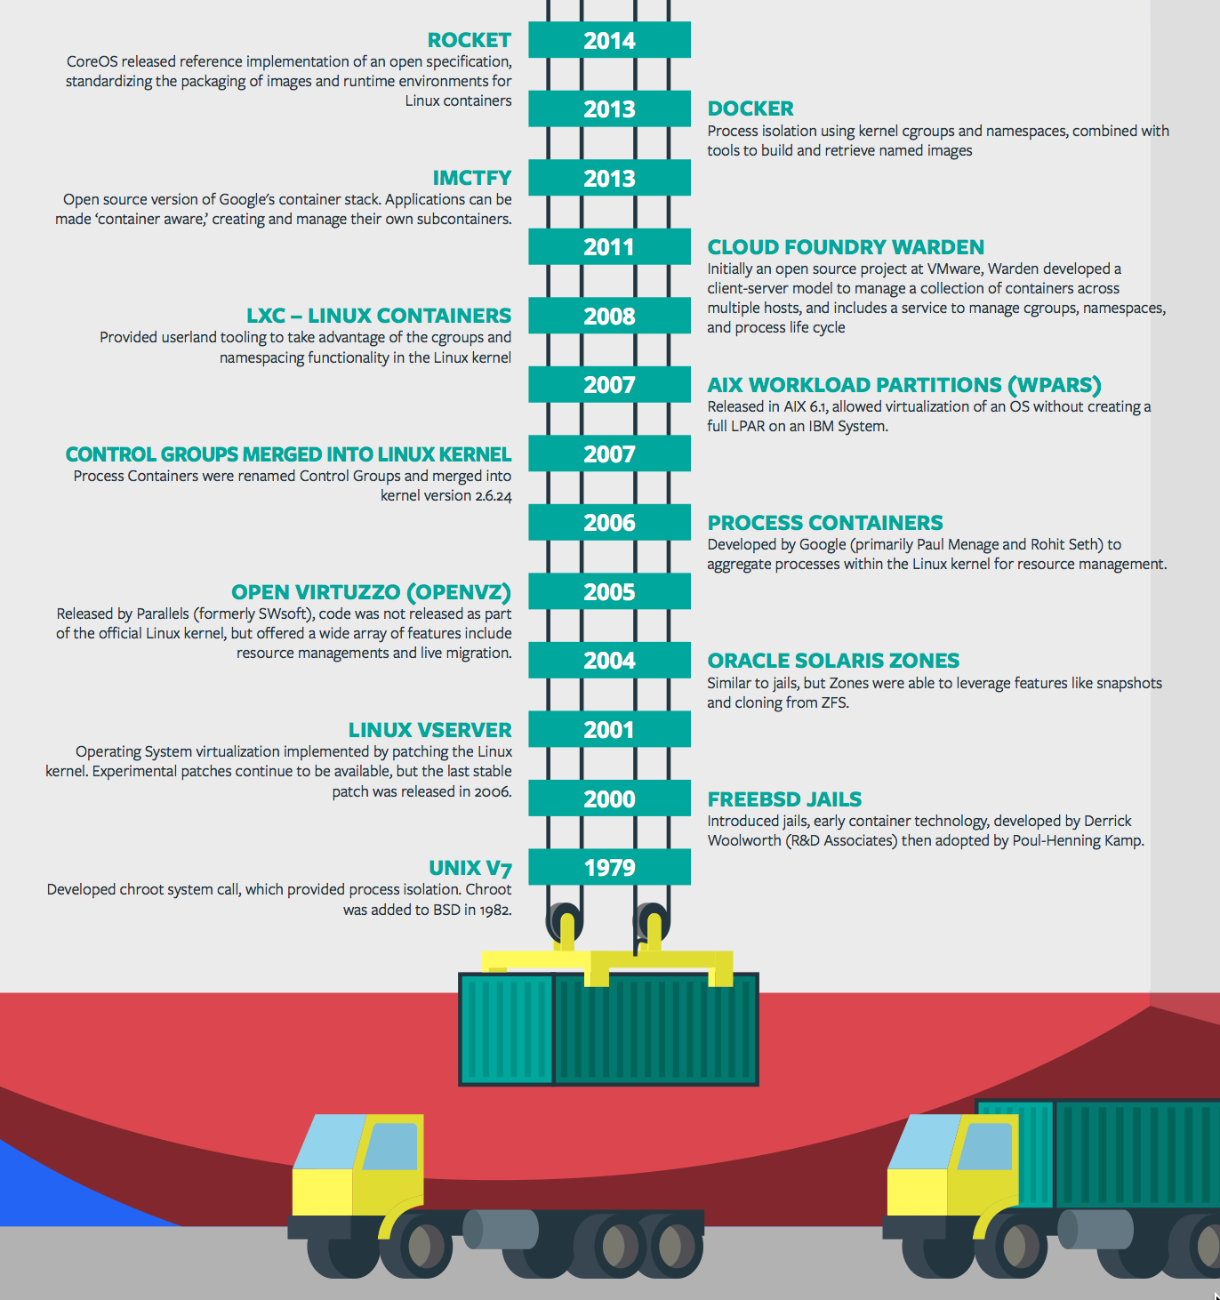
Containers - History
CONTAINERS!!!!
Containers are not new
CF has used containers since it’s inception
CF supports multiple container technologies as first class citizens including Docker, Warden, Garden and runC
Notes:
History of Docker
- 2006 Google to use containers they built cgroups and namespaces and pushed it to the Linux kernel
- cgroups and namespaces give you isolation (Resource Isolation and Namespace isolation)
- dotCloud and LXC fragmentation
- libcontainer created to address application portability and standard API across linux distros BUT controlled by Docker
- Open Container Project (Docker/dockerfile, CoreOS/appc). Standardiized on runC
- Standardizing the file format (dockerfile + appc = filesystem)
- Standardizing the runtime (libcontainer = runC)
- Container (Isolation + Files/metadata + Processes)

Slide 12
Application containers and scaling
App Ops
Blobstore
Cloud Controller
DB
Service
credentials
creds
Cloud Controller Bridge
Router
BBS
Converger & Auctioneer
Access App
Cell
Cell
Cell
creds
Notes:
Nsync splits its responsibilities between two independent processes:
The nsync-listener listens for desired app requests and updates/creates the desired LRPs via the BBS.
The nsync-bulker periodically polls CC for all desired apps to ensure the desired state known to Diego is up-to-date.
The BBS also provides a real-time representation of the state of the Diego cluster (including all desired LRPs, running LRP instances, and in-flight Tasks). The Converger periodically analyzes snapshots of this representation and corrects discrepancies, ensuring that Diego is eventually consistent.
Converger
maintains a lock in the BBS to ensure that only one converger performs convergence. This is primarily for performance considerations. Convergence should be idempotent.
uses the converge methods in the runtime-schema/bbs to ensure eventual consistency and fault tolerance for Tasks and LRPs
when converging LRPs, the converger identifies which actions need to take place to bring DesiredLRP state and ActualLRP state into accord. Two actions are possible:
if an instance is missing, a start auction is sent.
if an extra instance is identified, a stop message is sent to the Rep on the Cell hosting the instance.
periodically sends aggregate metrics about DesiredLRPs, ActualLRPs, and Tasks to Doppler.
Rep
represents a Cell and mediates all communication with the BBS by:
ensuring the set of Tasks and ActualLRPs in the BBS is in sync with the containers actually present on the Cell
maintaining the presence of the Cell in the BBS. Should the Cell fail catastrophically, the Converger will automatically move the missing instances to other Cells.
Route-Emitter
monitors DesiredLRP state and ActualLRP state via the BBS. When a change is detected, the Route-Emitter emits route registration/unregistration messages to the router
periodically emits the entire routing table to the router.

Slide 13
D e m o
Pivotal
Cloud Foundry
®

Slide 14
Pivotal Cloud Foundry
Multi-tenancy

Slide 15
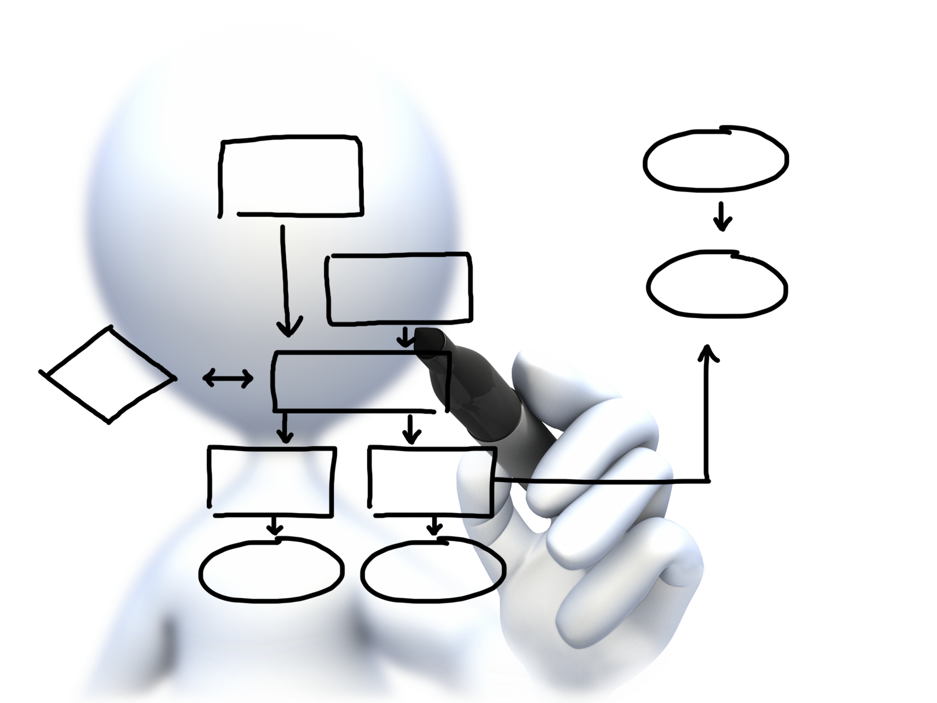
Orgs, Spaces, Users and Quotas
team-org
Quota
Memory
Routes
Users
Art
Spaces
Dev
Services
Apps
Test
Services
Apps
Steve
Chris
Services

Slide 16
Organizations
team-org
Quota
Memory
Routes
Users
Art
Spaces
Dev
Services
Apps
Test
Services
Apps
Steve
Chris
Services
Logical division within a Pivotal CF install / Foundation.
Each organization has its own users and assigned quota
User permissions / roles are specified per space within an organization
Sub-divided into Spaces

Slide 17
Spaces
team-org
Spaces
Dev
Services
Apps
Test
Services
Apps
Prod
Services
Apps
Logical sub-division within an organization
Users authorized at an organization level can have different roles per space
Services and Applications are created / specified per Space
Same Service can have different meanings per space

Slide 18

Quotas and Plans
Different quota limits (e.g. “small”, “enterprise”, “default”, “runaway”) can be assigned per Organization
Quota defines
Total Memory
Total # of Services
Total # of Routes

Slide 19
D e m o
Pivotal
Cloud Foundry
®
Notes:
DEMO
Show Apps Manager interface
Explain organizations, usage report, and spaces
Command line: cf org instructor-org to show quota
Show Membership to orgs and spaces
Drill into dev space and explain app and service contents

Slide 20
Pivotal Cloud Foundry
Services

Slide 21
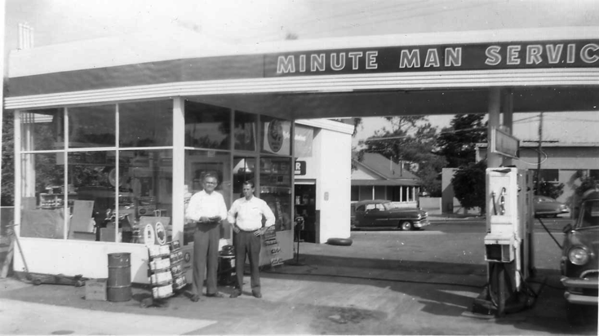
What is a Service
Allows resources to be easily provisioned on-demand
Typically middleware, frameworks, and other “components” necessary for applications
Can be a persistent, stateful layer

Slide 22

Two Types of Services
Managed Fully integrated, with full lifecycle management
User-Provided Created and managed external to the platform

Slide 23
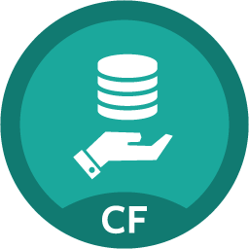
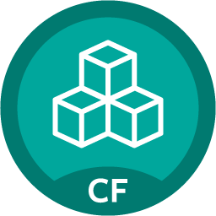

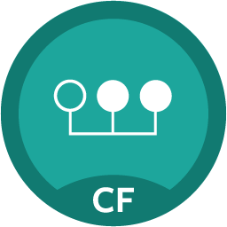
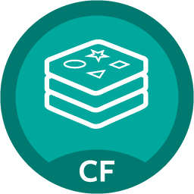

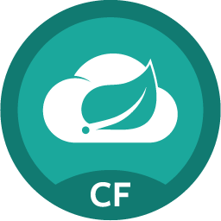
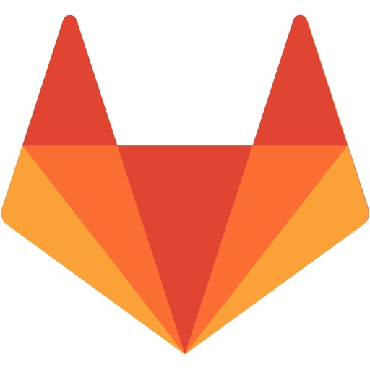
Rapid self-service provisioning
Push button deployed service instance
Bind to apps through easy to use interface
Easy accessibility through Marketplace including Spring Cloud Services
Common access control and audit trails across the breadth of services
System > Marketplace
MySQL
Pivotal GemFire for PCF
RabbitMQ
Session state caching powered by Pivotal GemFire
Redis
Cloudbees Jenkins Enterprise
Spring Cloud Services
GitLab Enterprise
23
Notes:
The integrated approach extends to the Cloud Native Runtime’s integration, with Spring Cloud services being pre-packaged for simple consumption on the platform through our built in marketplace. One leading satellite entertainment provider called this unique blend of microservices supporting features a “no brainer” for their next generation digital services platform. Spring cloud along w/ Spring boot take a developer from idea to a functioning microservice in minutes.
Demo 4 – Environmental elasticity with lazy service binding
Marketplace overview in Pivotal CF App Manager (PCF1) and PWS (run.pivotal.io)
In 4-Prod space, create a new App Autoscaler service called scale-gold
Bind scale-gold service to payments app
In a later demo, the scale-gold service will be used
Demo 5 – Manual & auto -scaling to handle varying workloads
From with Pivotal App Manager console, manually scale payments app to 2 instances
Note number of app instances has scaled to service more users
Manage the scale-gold service to start auto-scaler on the payments app and set the min instances to 3 and max instances to 10.
Within 30 seconds, auto-scaler should increase the payments app instances to 3
Bind each of the following apps to scale-gold: consumer-messaging service, payment-service, and payment-history-service
Manage the scale-gold service and review all apps being managed by the auto-scaler service.

Slide 24
Creating and Binding a Service
Service
credentials
DB
CLI
create service (HTTP)
Cloud Controller
create service (HTTP)
Service
Broker
reserve resources
Data
Service
Router
bind service (HTTP)
bind service (HTTP)
obtain connection data
Cloud Foundry
Elastic Runtime
Notes:
Cloud Foundry PaaS
An application runs in a Cell, which is a droplet execution agent. The Cloud Controller orchestrates the routing and lifecycle of all Cells in the pool. Routers manage application traffic. Health Manager reports mismatched application states to the CC. A service gateway provides an interface for services (native or external). A messaging bus manages all system communication. Apps are accessed directly through the router while web and CLI clients (e.g., vmc, STS) access Cloud Controller via RESTful services.

Slide 25
D e m o
Pivotal
Cloud Foundry
®
Notes:
DEMO
Review PCF1 Marketplace
Review PWS Marketplace
Add a service and bind it to the demonstration app
Show service credentials
Restart or restage demo app as necessary
Show demo app with bound service

Slide 26
Pivotal Cloud Foundry
Architecture & 4 Layers of High Availability

Slide 27






Elastic Runtime High Level Architecture
Automated Platform-as-a-Service
Scalable runtime environment, extensible to most modern frameworks and languages running on Linux
Instant expansion or upgrade with no downtime
Deploy, scale and manage applications with bindable services using simplified semantics and APIs
Pivotal CF Elastic Runtime
Dynamic Router
ROUTING
OAuth 2.0 Server (UAA)
Login Server
AUTHENTICATION
CC & CC Bridge
BBS
Converger
APP LIFECYCLE
BBS/etcd
MESSAGING
Service Brokers
CELL
Blob Store
APP STORAGE
& EXECUTION
Garden
Build Packs
Sys Log
Collector
App Log
METRICS &
LOGGING
Pivotal CF OpsManager/BOSH
Notes:
First, it’s important to understand that the Cloud Foundry Elastic Runtime is, itself, a collection of microservices running on virtual machines. These services govern the health of your containerized applications, provide centralized logging aggregation, automatic scaling and load balancing, etc. Let’s take a look at an example of an inbound HTTP request to our sample application:

Slide 28
HA 1 - Failed Application Instances Replaced
App Ops
Desired State
Blobstore
Cloud Controller
DB
Service
credentials
creds
Cloud Controller Bridge
Router
BBS
Converger & Auctioneer
Access App
Cell
Cell
Cell
creds
creds
Actual State
Notes:
Nsync splits its responsibilities between two independent processes:
The nsync-listener listens for desired app requests and updates/creates the desired LRPs via the BBS.
The nsync-bulker periodically polls CC for all desired apps to ensure the desired state known to Diego is up-to-date.
The BBS also provides a real-time representation of the state of the Diego cluster (including all desired LRPs, running LRP instances, and in-flight Tasks). The Converger periodically analyzes snapshots of this representation and corrects discrepancies, ensuring that Diego is eventually consistent.
Converger
maintains a lock in the BBS to ensure that only one converger performs convergence. This is primarily for performance considerations. Convergence should be idempotent.
uses the converge methods in the runtime-schema/bbs to ensure eventual consistency and fault tolerance for Tasks and LRPs
when converging LRPs, the converger identifies which actions need to take place to bring DesiredLRP state and ActualLRP state into accord. Two actions are possible:
if an instance is missing, a start auction is sent.
if an extra instance is identified, a stop message is sent to the Rep on the Cell hosting the instance.
periodically sends aggregate metrics about DesiredLRPs, ActualLRPs, and Tasks to Doppler.
Rep
represents a Cell and mediates all communication with the BBS by:
ensuring the set of Tasks and ActualLRPs in the BBS is in sync with the containers actually present on the Cell
maintaining the presence of the Cell in the BBS. Should the Cell fail catastrophically, the Converger will automatically move the missing instances to other Cells.
Route-Emitter
monitors DesiredLRP state and ActualLRP state via the BBS. When a change is detected, the Route-Emitter emits route registration/unregistration messages to the router
periodically emits the entire routing table to the router.

Slide 29
HA 2 - Elastic Runtime Processes are Monitored
PaaS Ops
BBS
AGENT
Health Monitor
Responses:
CELL
pager
AGENT
Message Bus
email
monitoring
…
Cloud Controller
AGENT
Pivotal CF Operations Manager
IaaS
Notes:
The processes running on the virtual machines (i.e. the health manager) are started with monit, a nice little utility that keeps an eye on processes and will respond when one dies. If a process dies then, monit will do two things: first, it will try to restart the process and second, whether the restart is successful or not, it will tell the BOSH agent about the failure. Recall that the Bosh agent is there to communicate with Operations Manager and in this case it will relay this failure information to the Operations Manager Health Monitor (not to be confused with the Health Manager of the elastic runtime that was discussed above) – we’ll abbreviate it OMHM. The OMHM will take this alert and pass it through a list of responders that can be configured to do things like send emails, page administrators and display alerts in operations dashboards. There’s a good chance that monit will already have recovered the process, but we also want there to be an opportunity for a human to respond.

Slide 30
HA 2 - Elastic Runtime Processes are Monitored
PaaS Ops
BBS
AGENT
Health Monitor
Responses:
CELL
pager
AGENT
Message Bus
email
monitoring
…
Cloud Controller
AGENT
Pivotal CF Operations Manager
IaaS
Notes:
The processes running on the virtual machines (i.e. the health manager) are started with monit, a nice little utility that keeps an eye on processes and will respond when one dies. If a process dies then, monit will do two things: first, it will try to restart the process and second, whether the restart is successful or not, it will tell the BOSH agent about the failure. Recall that the Bosh agent is there to communicate with Operations Manager and in this case it will relay this failure information to the Operations Manager Health Monitor (not to be confused with the Health Manager of the elastic runtime that was discussed above) – we’ll abbreviate it OMHM. The OMHM will take this alert and pass it through a list of responders that can be configured to do things like send emails, page administrators and display alerts in operations dashboards. There’s a good chance that monit will already have recovered the process, but we also want there to be an opportunity for a human to respond.

Slide 31
HA 2 - Elastic Runtime Processes are Monitored
PaaS Ops
BBS
AGENT
Health Monitor
Restart!
Responses:
CELL
pager
AGENT
Message Bus
email
monitoring
…
Cloud Controller
AGENT
Pivotal CF Operations Manager
IaaS
Notes:
The processes running on the virtual machines (i.e. the health manager) are started with monit, a nice little utility that keeps an eye on processes and will respond when one dies. If a process dies then, monit will do two things: first, it will try to restart the process and second, whether the restart is successful or not, it will tell the BOSH agent about the failure. Recall that the Bosh agent is there to communicate with Operations Manager and in this case it will relay this failure information to the Operations Manager Health Monitor (not to be confused with the Health Manager of the elastic runtime that was discussed above) – we’ll abbreviate it OMHM. The OMHM will take this alert and pass it through a list of responders that can be configured to do things like send emails, page administrators and display alerts in operations dashboards. There’s a good chance that monit will already have recovered the process, but we also want there to be an opportunity for a human to respond.

Slide 32
HA 3 - VMs are Monitored
PaaS Ops
BBS
Desired State
Actual State
AGENT
Health Monitor
BOSH Director
Responses:
CELL
pager
AGENT
Message Bus
email
monitoring
ressurector
Cloud Controller
…
AGENT
Pivotal CF Operations Manager
IaaS
Notes:
Of course, the BOSH agent on a VM can only communicate back to the Operations Manager if the VM is there, so let’s talk about what happens when a VM disappears. First thing to understand is that by “disappear” I mean that the BOSH agent is not functional; the VM could be there, but Ops Manager no longer knows what it is up to so for all intents and purposes it’s “gone”. How does Ops Manager know? One of the things that a BOSH agent is responsible for is sending out heartbeat messages and by default it does so every 60 seconds. The OMHM is constantly listening for those heartbeats and when it finds that one is missing it will itself produce and alert and pass that through the list of responders. Just as described above, this could result in emails, pages and operations dashboard alerts, but in this case there is one more responder that kicks in – the “resurector”. The resurector will communicate with the IaaS over which PCF is running and will ask that the failed VM be replaced. Of course it will be replaced with a VM running the appropriate part of the elastic runtime – i.e. a health manager or Cell, etc. That’s right, Operations Manager will restart failed cluster components.

Slide 33
HA 3 - VMs are Monitored
PaaS Ops
BBS
Desired State
Actual State
AGENT
Health Monitor
BOSH Director
Responses:
CELL
pager
AGENT
Message Bus
email
monitoring
ressurector
Cloud Controller
…
AGENT
Pivotal CF Operations Manager
IaaS
Notes:
Of course, the BOSH agent on a VM can only communicate back to the Operations Manager if the VM is there, so let’s talk about what happens when a VM disappears. First thing to understand is that by “disappear” I mean that the BOSH agent is not functional; the VM could be there, but Ops Manager no longer knows what it is up to so for all intents and purposes it’s “gone”. How does Ops Manager know? One of the things that a BOSH agent is responsible for is sending out heartbeat messages and by default it does so every 60 seconds. The OMHM is constantly listening for those heartbeats and when it finds that one is missing it will itself produce and alert and pass that through the list of responders. Just as described above, this could result in emails, pages and operations dashboard alerts, but in this case there is one more responder that kicks in – the “resurector”. The resurector will communicate with the IaaS over which PCF is running and will ask that the failed VM be replaced. Of course it will be replaced with a VM running the appropriate part of the elastic runtime – i.e. a health manager or Cell, etc. That’s right, Operations Manager will restart failed cluster components.

Slide 34
HA 3 - VMs are Monitored
PaaS Ops
CPI
BBS
Desired State
Actual State
AGENT
Health Monitor
BOSH Director
Responses:
CELL
pager
AGENT
Message Bus
email
monitoring
ressurector
Cloud Controller
…
AGENT
Pivotal CF Operations Manager
IaaS
Notes:
Of course, the BOSH agent on a VM can only communicate back to the Operations Manager if the VM is there, so let’s talk about what happens when a VM disappears. First thing to understand is that by “disappear” I mean that the BOSH agent is not functional; the VM could be there, but Ops Manager no longer knows what it is up to so for all intents and purposes it’s “gone”. How does Ops Manager know? One of the things that a BOSH agent is responsible for is sending out heartbeat messages and by default it does so every 60 seconds. The OMHM is constantly listening for those heartbeats and when it finds that one is missing it will itself produce and alert and pass that through the list of responders. Just as described above, this could result in emails, pages and operations dashboard alerts, but in this case there is one more responder that kicks in – the “resurector”. The resurector will communicate with the IaaS over which PCF is running and will ask that the failed VM be replaced. Of course it will be replaced with a VM running the appropriate part of the elastic runtime – i.e. a health manager or Cell, etc. That’s right, Operations Manager will restart failed cluster components.

Slide 35
HA 4 - Application Instances and Availability Zones
App Ops
Zone 1
Zone 2
Application instances are evenly distributed over two availability zones.
CELL
CELL
Loosing an AZ keeps instances running and available.
CELL
CELL
Router
CELL
CELL
Notes:
Zone could = rack, for example

Slide 36
How Pivotal CF enables four layers of HA
1.
2.
3.
4.
PCF
PCF
PCF
Zone 1
Zone 2
A
B
C
A
B
C
A
B
C
A
B
C
A
B
C
A
B
C
A
B
C
Process
VM1
VM2
VM3
B
B
B
B
3. Resurrector restarts failed VMs
VM1
VM2
B
A
B
C
A
B
C
A
B
C
A
B
C
OS,
Mware
OS,
Mware
OS,
Mware
B
B
B
B
If an app fails, PCF reboots app in a new container.
If a process fails, PCF restarts the process
If an OS or network failure occurs PCF kills the VM and reboots the host in a new Virtual machine.
If a datacenter rack fails, PCF ensures applications stay running in multiple availability zones
App Fail
Process Fail
VM Fail
Rack Fail
Notes:
Application performance and reliability have a direct correlation to HA capability. Pivotal provides 4 level of HA so that you don’t need to invest in people/software to handle common failure situations. If an application fails, we will reboot it in a new container. This automated remediation addresses application bugs that result in outages. If a Pivotal process fails, we will reboot it in a new virtual machine. Our PaaS essentially monitors and remediates itself. If an OS or network failure occurs, our VM monitor will detect this and kill the VM, then reboot it in a new container. This streamlines Linux sysadmin operations. Lastly, if a datacenter rack fails, we will ensure the application stays running because we load application instances in multiple availability zones. No 2 availability zones live on the same datacenter rack. This hardware failure level resilience is very difficult to design using traditional tools provided by HP/CA/IBM.
And, by using Pivotal, you reduce the number of servers that require HP/CA/IBM monitoring tools.
http://blog.pivotal.io/cloud-foundry-pivotal/products/the-four-levels-of-ha-in-pivotal-cf
Desired State of Application is maintained by Cloud Controller. Cells communicate status of their apps to BBS. BBS checks with Auctioneer. Auctioneer restarts app in another Cell in case of failure
PCF Processes monitored by monit and restarted in case of failure
In case of VM failure. Health Monitor is notified. HM calls BOSH Director which calls Resurrector component which starts up the VM (with processes)
Availability Zones is a logical grouping of the deployment of System Components and Cells. (Example would be two racks in a datacenter)

Slide 37
Pivotal Cloud Foundry = Enterprise-grade Platform
Cloud-scale, distributed, self-healing, eventually consistent architecture
Similar patterns in Elastic Runtime (for your apps) and BOSH (for your services)
Declarative – you declare your desired state and Pivotal Cloud Foundry keeps the system consistent with that desired state (4 levels of HA!!)
Zero-downtime, rolling upgrades
Pivotal Cloud Foundry manages containers (ERS) and VMs (BOSH)

Slide 38


Auditing and Logging
Inside of a Highly Distributed System
Notes:
At Pivotal, we believe Transforming how the world builds software will shape the future.
This is our core guiding principle that shapes our product and corporate strategy

Slide 39

Visibility Through Logs and Metrics
Single source for all platform logs and metrics. Single view console that makes system and application monitoring visible and actionable
First packet logging
Enables tool for external audit controls
Aggregated Logging
HTTP Events, Counters, Gauges, Errors
Every stdout and stderr from all apps and platform components
Health gauges
Snap-in best of breed application monitors
AppDynamics, New Relic, Splunk, etc.
Notes:
Application performance monitoring is built into the platform. Pivotal aggregates and streams all system logs, including the load balancer, application, middleware, and operating system. We also log and aggregate application deployment and scale events. You can combine Pivotal with Splunk or use a lower cost log event correlation system because we handle aggregation of multiple log sources. `When it comes to application metrics, we provide a multitude of IT operator data points, including routing counters and VM CPU/RAM health statistics. Each line of business can turn on auto-scaling that will increase/decrease the application instances when average CPU utilization goes up/down.
Lastly, Pivotal recognizes that some vendors can add monitor capabilities above/beyond what we provide. We strongly caution you against using “legacy” platforms like CA and HP, but App Dynamics and New Relic are PaaS aware and work out of the box with Pivotal CF.

Slide 40
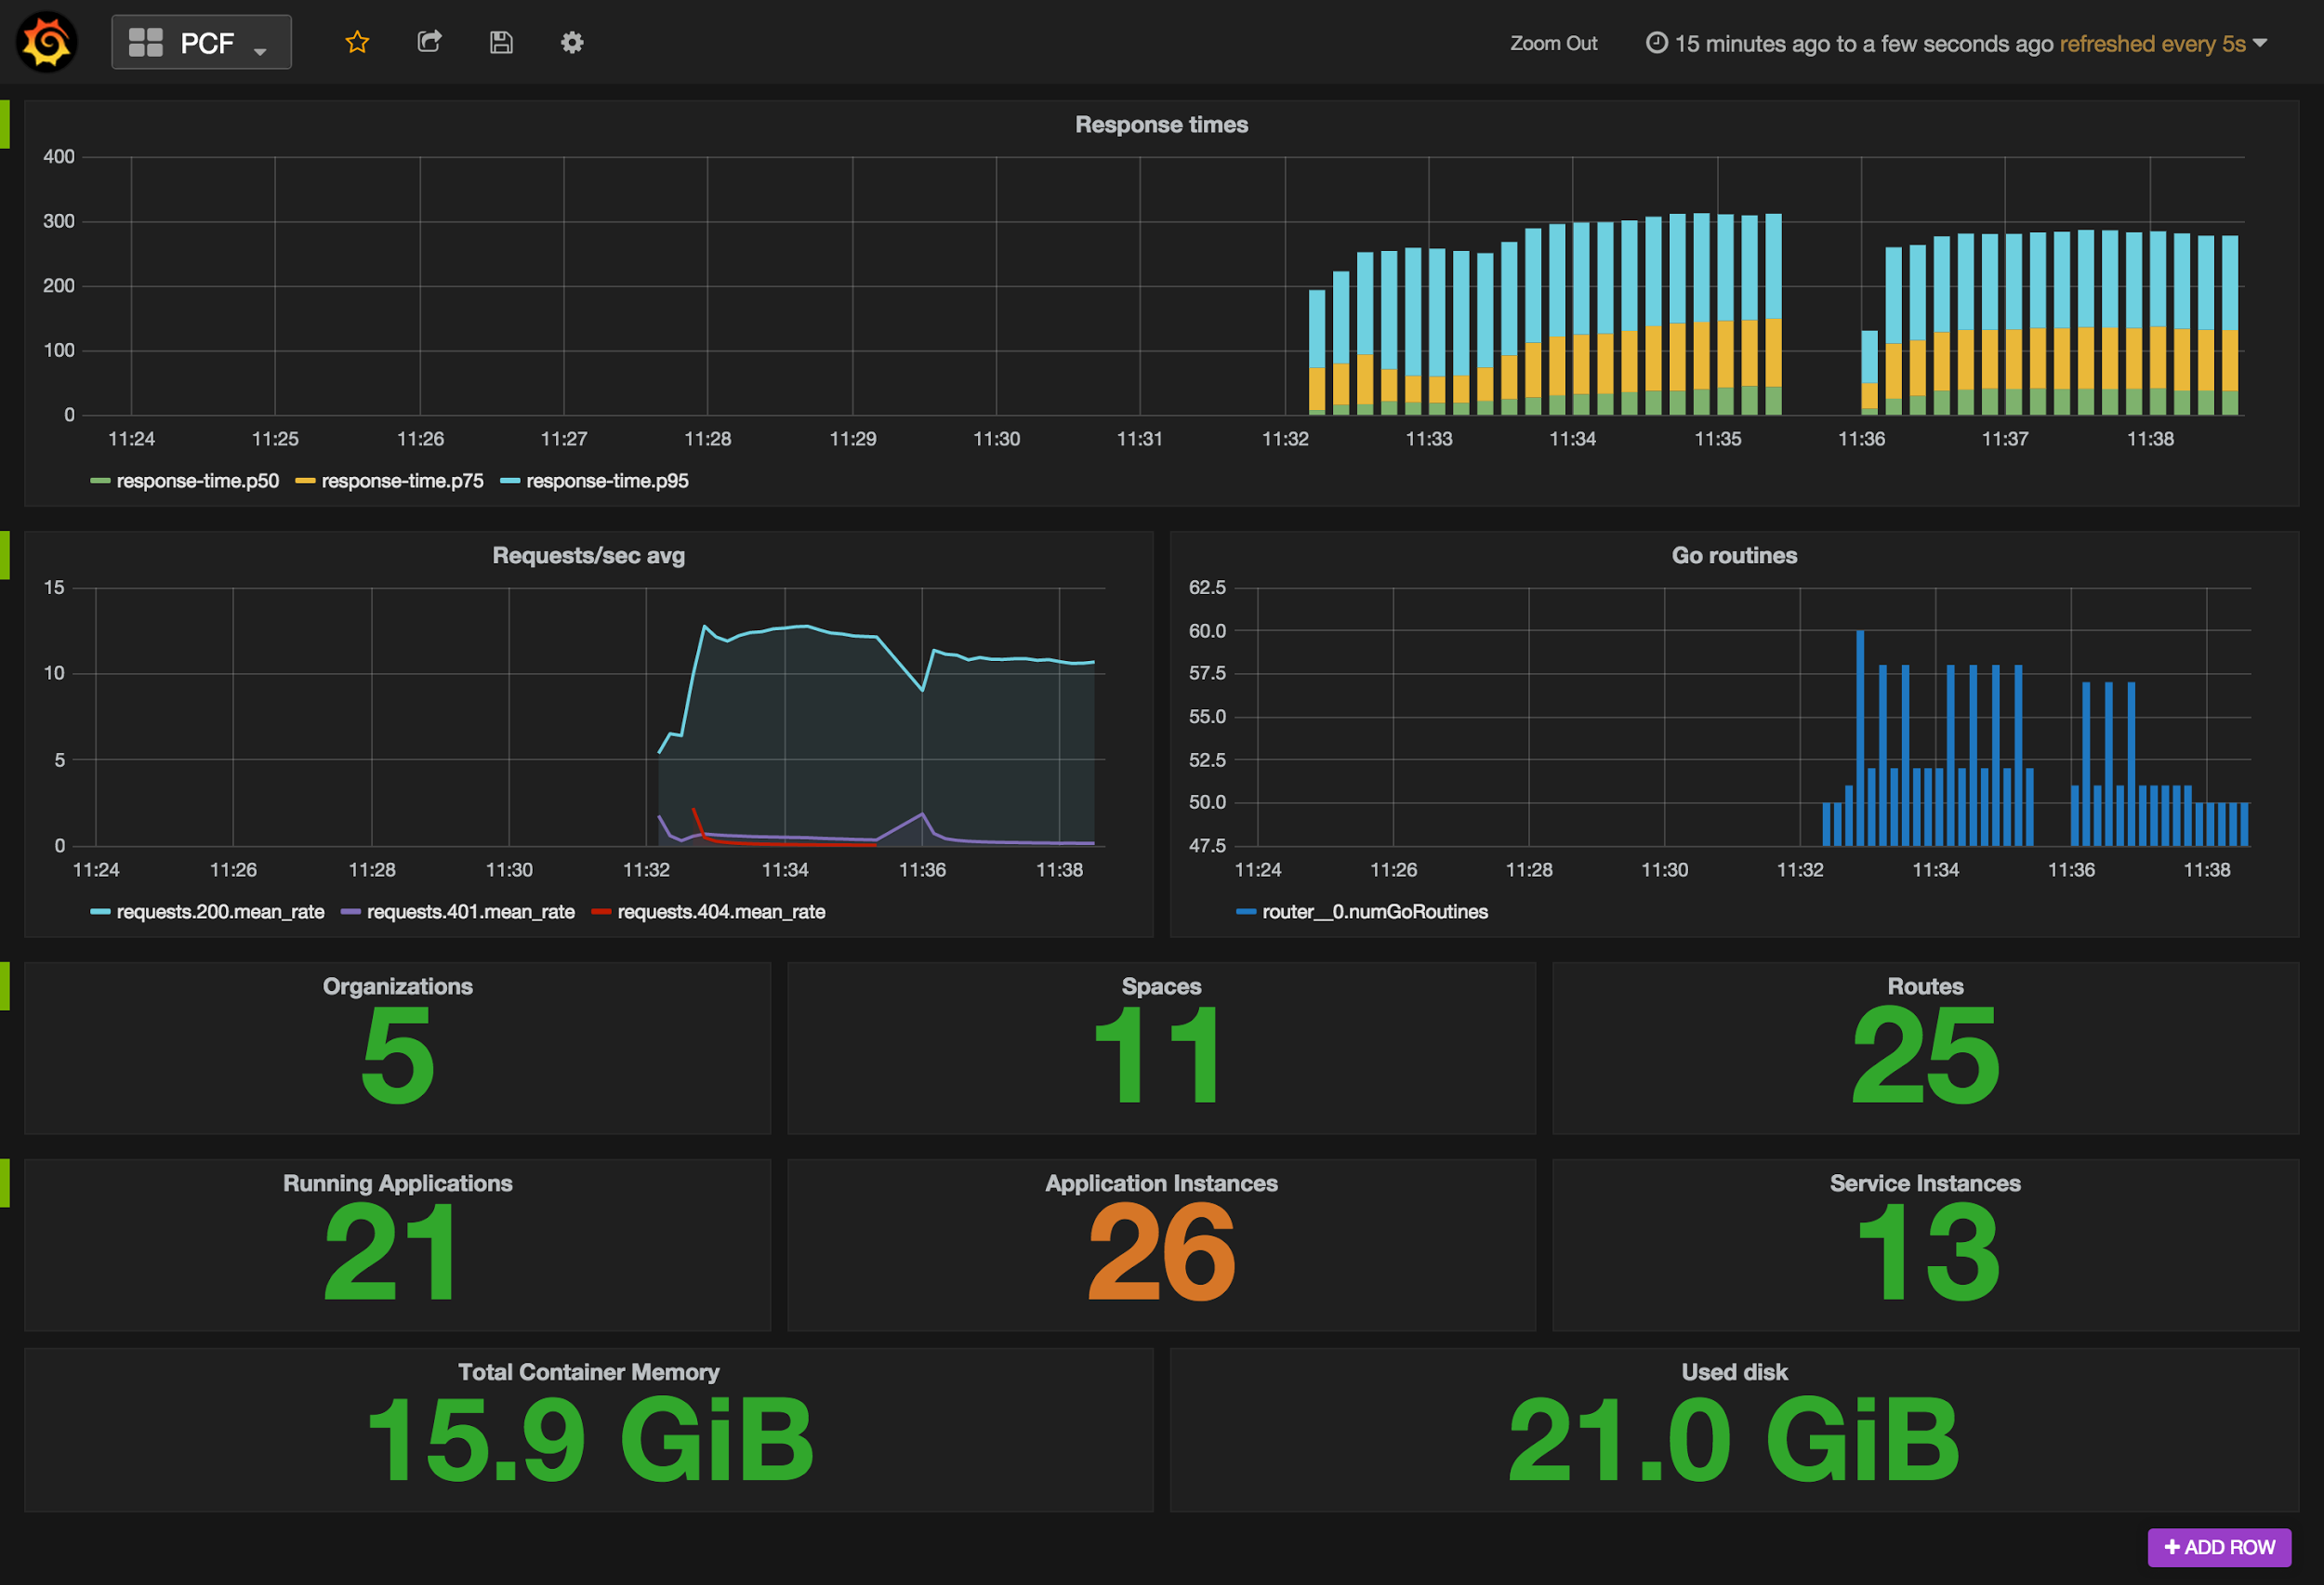
Platform Operations Logging
Platform Operations Logging Firehose
Overall Platform Health
Resource Utilization
Request Volumes / Latency

Slide 41
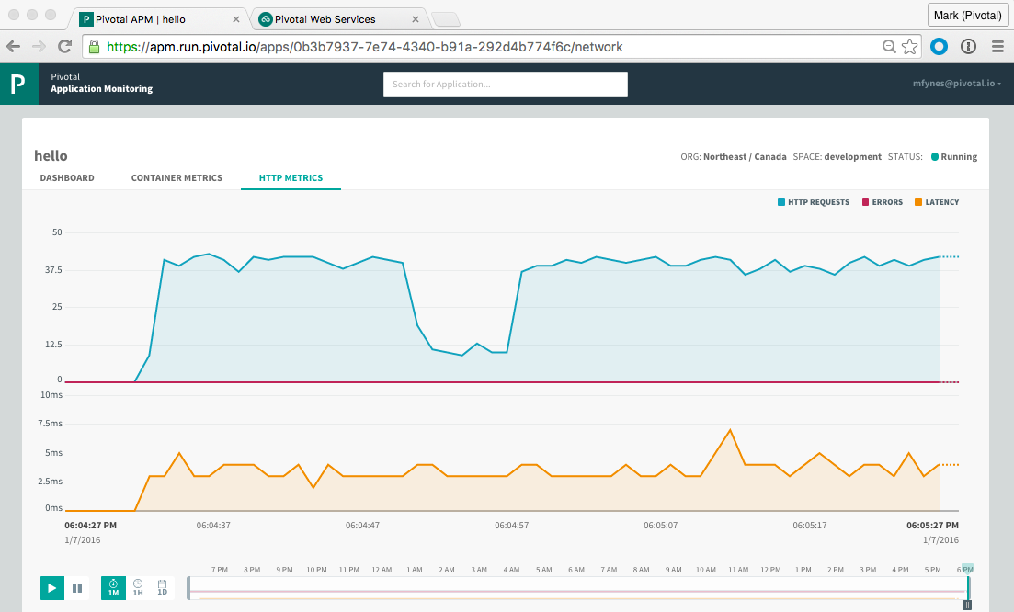
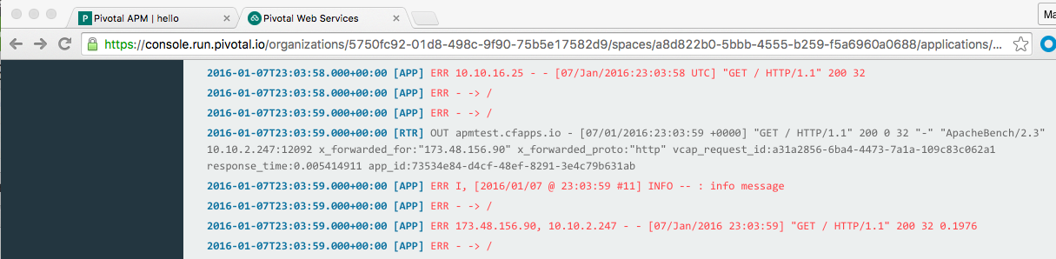
Application Operations Logging & Metrics
Self-service per-application APM dashboards
Per-application log-streams including relevant CF Router activity

Slide 42

HANDS-ON LABS
Pivotal
Cloud Foundry
®
Notes:
IMPORTANT PREPARATION
Create a digital-arch organization with spaces 1-Dev, 2-Test, and 3-Prod spaces
Use the “Setup a Space” instructions to create apps and services in all three spaces and import initialization data
Delete payments-service app instance from the digital-arch 1-Dev space
Delete scale-gold service, if there
Open App Manager to the org digital-arch and space 4-Prod
Start up the payments app from the 4-Prod space to demo app
Open terminal window to “cf target –o digital-arch –s 1-Dev”
Open STS to api-gateway (payments) app and open index.html and styles.css
Ensure connection to Jenkins service is good. (https://cbusch.ci.cloudbees.com)
Open https://papertrailapp.com
Setup a space
In a terminal window, navigation to the mc_source home directory
Connect to a CF instance org and space with Auto-scale, MySQL and RabbitMQ tiles
Run one of the deployment scripts
./deploy-dev.sh – route host names end with “-dev”
./deploy-test.sh – route host names end with “-test”
./deploy-prod.sh – route host names are the app names
Apps consumer-messaging-server, payment-service and payment-history-service are bound to separate databases and need initialized
consumer-messaging-server
open the phpmyadmin-consumer app details view
use service credentials of bound MySQL service
open the phpmyadmin-consumer app and use creds from bound service
click on the database “cf_xxxx” then click Import import the DDL from ConsumerMessagingWS src/main/resources/data/ddl.sql
Click the push_notif_config table then the Query tab and past the contents of the ConsumerMessagingWS src/main/resources/data/data.sql into the field and click Go to import the data
payment-history-service
open the phpmyadmin-pay-hist app details view
use service credentials of bound MySQL service
open the phpmyadmin-pay-hist app and use creds from bound service
click on the database “cf_xxxx” then click the payment table
click the Query tab and import the payment-history-service src/main/resources/import.sql and click Go to import the data
payment-service
use the same instructions above for the payment-service so that it contains the same data as payment-history-service
Create Jenkins “Payment app test project”
Add a Post Action to call the production script if build successful
Create Jenkins “Payment app prod project”

Slide 43
Hands-on Lab Instructions
Prerequisites
CF CLI installed
git clone https://github.com/cbusch-pivotal/Cloud-Native-Workshop.git
Lab instructions
https://github.com/cbusch-pivotal/Cloud-Native-Workshop

Slide 45



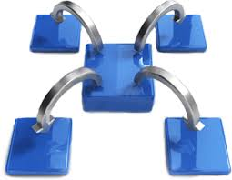
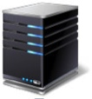







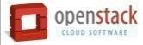

Pivotal CF: Technical Capabilities
Automatic App Server & OS Configuration with Buildpacks (“just push your app”)
Application
Containerization & Cluster Scheduling
Application Network Security Groups
App Health Management, Load Balancing,
Rapid Scaling, Availability Zones
Application to Services Binding and Access
Policy, Identity and Roles Management
Logging as a service,
Application metrics & performance,
Metric based scaling
Native & Extended Data, Mobile and Platform Services
IaaS Provisioning, Scaling & Configuration
Deploy, Operate, Update & Scale with minimal downtime on choice of IaaS
Notes:
Key Platform Capabilities
On Demand Scaling
Application Health Management
Dynamic Routing & Load Balancing
Log and Metric Aggregation
Security
WHAT
Pivotal CF is next generation middleware that delivers 9 things that are typically delivered via point software products.
We provision operating systems and middleware.
We deliver workload density without compromising application performance.
We ensure that applications have appropriate network security safe guards to prevent security threats.
We support application connections to external sources including databases and legacy middleware.
We provide 4 levels of HA, with built in load balancing for scale in/out
We support multi-tenant environments so that each line of business can operate with a discrete quota and isolated system access.
We provision next generation data services including NOSQL databases, traditional databases and hadoop clusters.
We provide horizontal and vertical scaling for the underlying IaaS so that you can scale your infrastructure in lock step with your Business.
We provide a built-in log aggregation service, built-in APM metrics and utilization based auto-scaling so that you can monitor the health of your applications and scale out without human or 3rd party tool intervention.
I am going to cover each of these 9 capabilities in more detail, but it’s important to note the impact of this collection of capabilities. The following slides will include information on CAPEX and OPEX reduction. We will also discuss how you can deliver faster time to value while holding the line on infrastructure cost.

Slide 46
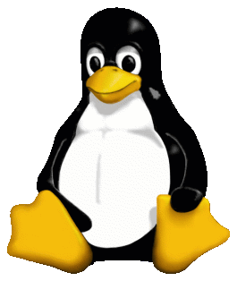
Container Isolation
shared resources
resource isolation
kernel
namespace isolation
process F
process A
process E
process B
process D
process C
tenant 1
tenant 2
tenant 3

Slide 47


Container Isolation
CPU
resource isolation
namespace isolation
cgroups
process D
process F
process F
process E
process A
process E
process B
process D
process C
tenant 1
tenant 2
tenant 3

Slide 48
Container Isolation
PID
2
3
4
2
2
3
resource isolation
namespace isolation
PID namespace
process F
process A
process E
process B
process D
process C
tenant 1
tenant 2
tenant 3

Slide 49
Container Isolation
shared resources
resource isolation
kernel
namespace isolation
namespaces
PID
process F
process A
process E
process B
process D
process C
Network
Mount
User
tenant 1
tenant 2
tenant 3

Slide 50
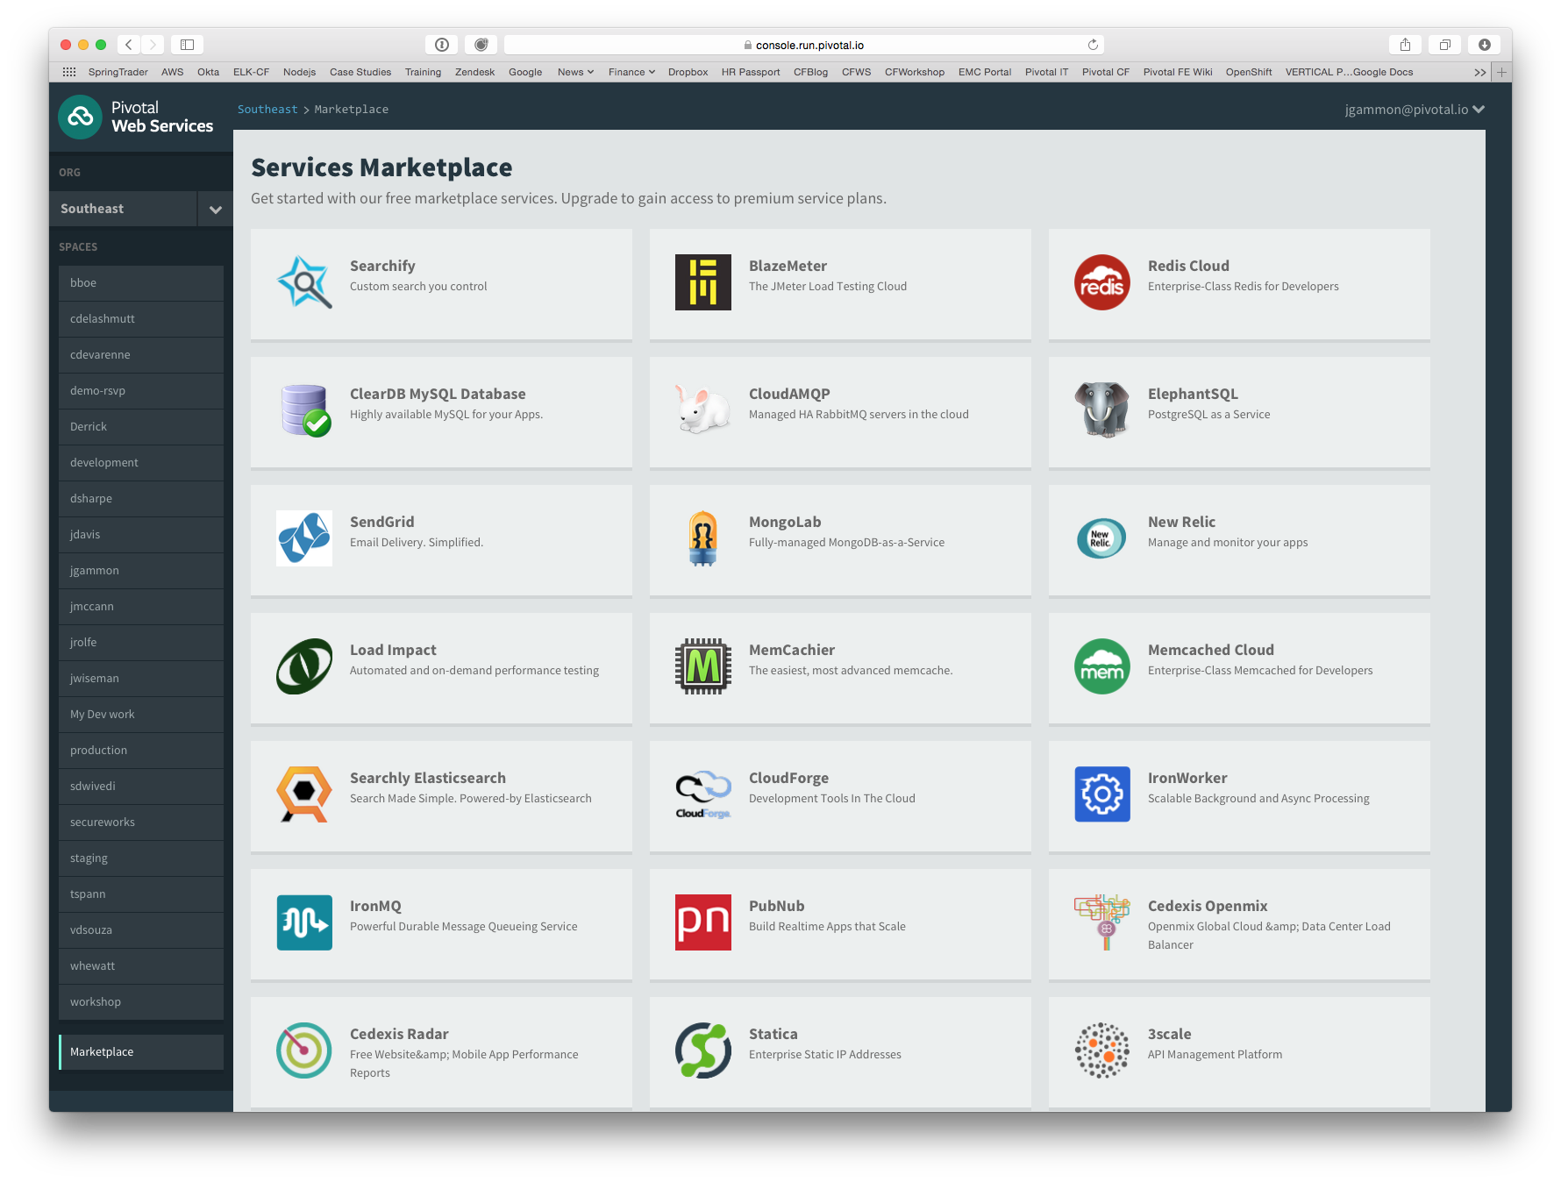
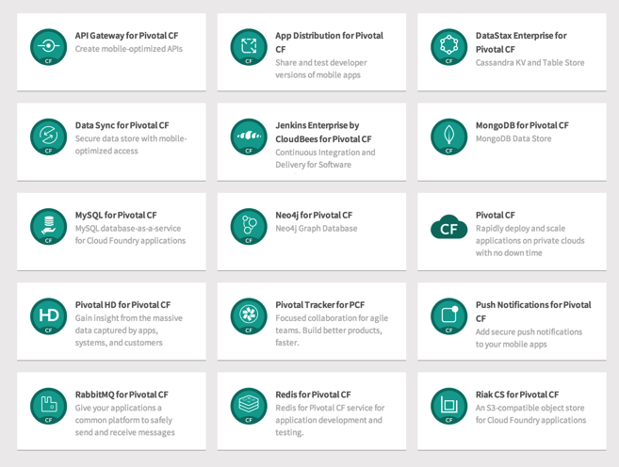
PCF Marketplace
Broad Services Ecosystem
Easy accessibility
Quick, self-provisioning

Slide 51
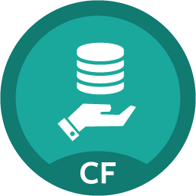
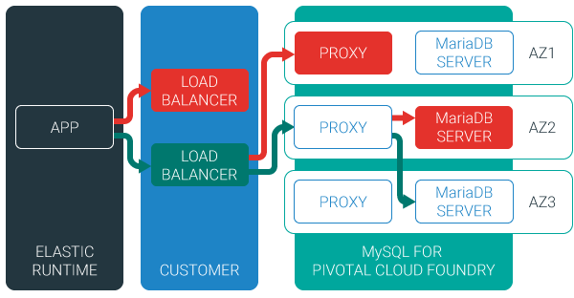
MySQL for Pivotal Cloud Foundry
Relational Database as a Service for Your Applications
Minimized effort to create, configure, and manage a MySQL cluster
Multi-node cluster
Data replication across nodes
Failover functionality ensures app traffic only routed to healthy nodes
Notes:
Deployed with a multi-node cluster; Balanced across Availability zones
Highly Available
Data replication
Failover functionality
Customizable plans
Secure - Different credentials to each application, operators can revoke access selectively!

Slide 52

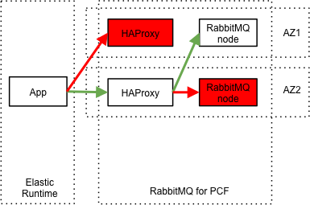
RabbitMQ for Pivotal Cloud Foundry
Apps safely send and receive messages at scale
Messaging broker for communication between servers, applications and devices
Highly available queues, flexible routing, support for multiple protocols and client libraries
Wide range of client libraries, in all languages
Push button deployment and upgrades of a RabbitMQ Cluster

Slide 53
Session State Caching (SSC) by GemFire
Configure, manage, monitor, and consume GemFire in a client/server topology
A turn-key GemFire session replication cache service optimized for Java buildpack apps deployed in Tomcat
No need to modify your app
Tomcat from the java buildpack “knows” how to use the service
GemFire pre-configured for session replication
Session state management independent from app servers
App servers can come and go without affecting session lifetime
Not affected by load balancing

Slide 54
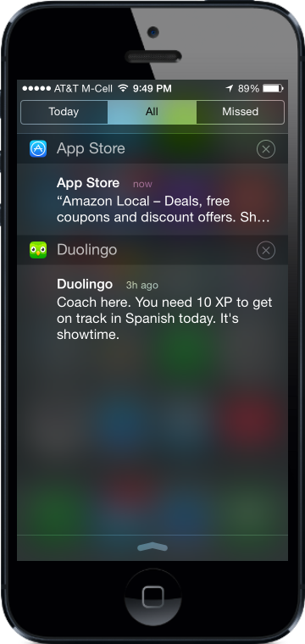
Push Notifications
Problem
Push is difficult to implement across platforms and at scale
Most existing push solutions are public / shared
Data owned by SaaS provider and cannot be fully leveraged by enterprise
Difficult to integrate SaaS push providers with services behind the firewall
Solution / Benefits
Dedicated, comprehensive solution built to scale
Full control of data and comprehensive logging / tracing
Direct integration with enterprise services

Slide 55
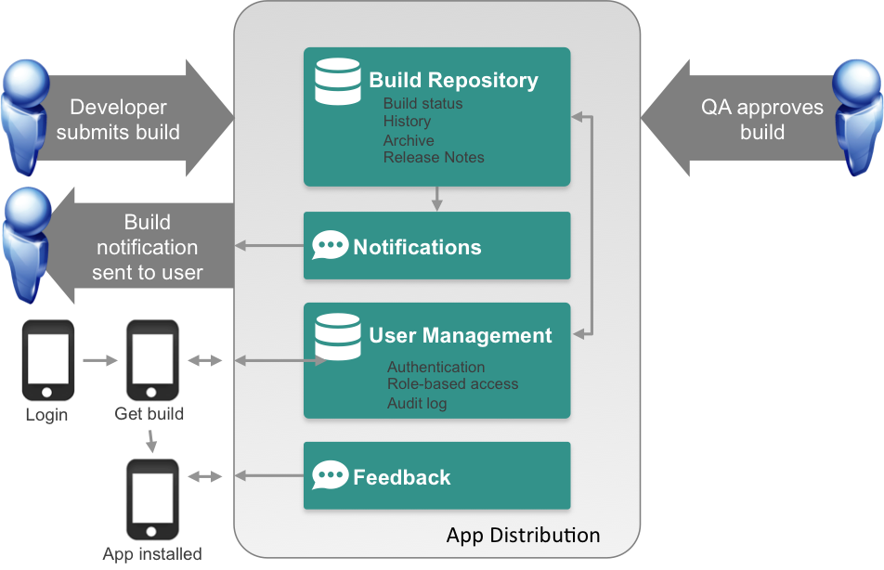
App Distribution
Problem
Extensive user testing of apps is critical to success
Difficult to distribute pre-release apps to test users
Existing solutions are public cloud
Solution / Benefits
Easy OTA app distribution
User / team management
Supports all major platforms
Private cloud for control / security

Slide 56


Deploying the CF Runtime with Cloud Foundry BOSH
Operator
DB
Worker VMs
Deploy my CF
BOSH Director
Blobs
etcd
Message Bus
Deployment
Packages
Blobs
Source
Jobs
Manifest
CELL
Health Monitor
Target VM
Cloud Controller
Target VM
Cloud Foundry Operations Manager/BOSH
Target VM
IaaS

